Slide 1

Build the Enlightened Enterprise
An Overview of the Cool Store Demo
Powered by JBoss Enterprise Middleware –
Business Rules Management System v5.3.1
TITLE SLIDE: HEADLINE
Presenter name
Title, Red Hat
Date
Notes:
This is the quick introduction to the BRMS Cool Store demo.

Slide 2

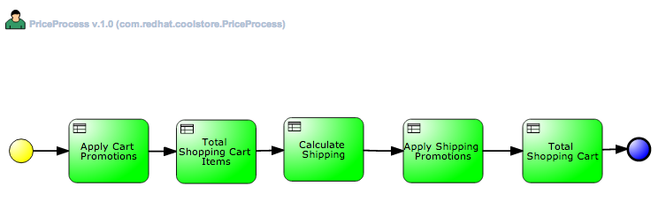
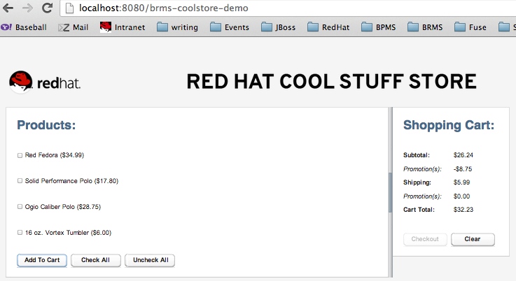

JBoss BRMS Cool Store Demo
Web-based development tools
(BRMS BRM)
Interacts with...
Decision
Service
Business Analysts
Business Process
Manager
Repository
Business Process Definitions
Business Rule & Event Definitions
Deploy
Java Code
Rule Engine
JBoss Developer Studio
Manage & Monitor
Developers
Business Data
Business Users
BRMS
Business Central
Operations
Notes:
Explain the layout of the BRMS components as related to the Cool Store Demo.
For Business demo, you have the repository filled from the web tooling, business user can play with rules and process artifacts, deploy them to the engine, interact via the Cool Store application that is deployed out onto EAP.
For developer demo, project is imported into the JBDS and artifacts can be developed, viewed, tested and deployed to engine, interaction with project from Cool Store application that is deployed out onto EAP.
Round tripping is possible when project is imported on one side (business web tooling or from JBDS project) and pulled into the other via the repository.

Slide 3
Cool Store
Notes:
Each interaction within the Cool Store is an event, this event stream is monitored and triggers the BPM workflow pictured when an item is added to your shopping cart.
The process uses rules, decision tables, etc. to determine eventual shipping costs, totals, and discouts to be applied to the shopping cart.
Note the submit button is commented out, it is about the shopping phase, not about checking out of the store.
Adjust decision table rows to increase for example the $4.99 fee for shipping to $14.99, don't forget to build the package, then redo your shopping cart to show that amount appearing instead of original amount. This is runtime modification of your application without redeploying.

Slide 4
Build the Enlightened Enterprise
For more information, please visit
http://www.jboss.com
Demo project available at:
http://github.com/eschabell/brms-coolstore-demo
TITLE SLIDE: HEADLINE
Presenter name
Title, Red Hat
Date
Notes:
Here you can find the demo, setup documentation and get started yourself.

